Slide 1





FINAL PROJECT IN NET 313 - ADVANCE NETWORKING
PROJECT TITLE: ADVANCED NETWORK ARCHITECTURE
WITH DHCP AND EIGRP OPTIMIZATION
GROUP 11

Slide 2


OBJECTIVE:
Design, implement, and optimize a network infrastructure for a technology hub facility using Cisco Packet Tracer. The network must meet the scalability, redundancy, and security demands of a tech-driven environment. Network performancewill be evaluated, and enhancements proposed based on real-world business needs.

Slide 3
Part 1: Company and Network Requirements

Slide 4


1. Define Your Company
Company Type: Technology Hub Facility
The tech hub facility provides a collaborative space for startups, IT professionals, and developers. It includesshared work spaces, conference rooms, and a dedicated data center. The network accommodates multipleclients,ensuring secure high-speed internet, dependable connectivity, and strong security measures.

Slide 5
Unique Networking Requirements:
Segmented networks for tenant isolation and administrator access
Scalable infrastructure to accommodate up to 500 users simultaneously
High bandwidth to handle concurrent operations and extensive data transfers.

Slide 6
Goals:
Performance:
Scalability:
Security:
Ensure stable, low-latency connections.
Expand seamlessly as the user base increases.
Protect client data and comply with industry standards.
$42.00
$42.00

Slide 7

2. Analyze Business Needs
IP Addressing: 
Static IPs: Reserved for critical devices such as routers, servers, and printers. 
Dynamic IP Allocation: Provided via DHCP for client devices in each subnet.

Slide 8

Security Requirements:
VLAN segmentation to isolate tenant traffic from administrative operations. 
Strong device authentication (e.g., WPA3) and encryption protocols (SSL/TLS). 
Firewalls, intrusion detection/prevention systems (IDS/IPS), and access control lists (ACLs).

Slide 9
Part 2: Network Design and Planning

Slide 10
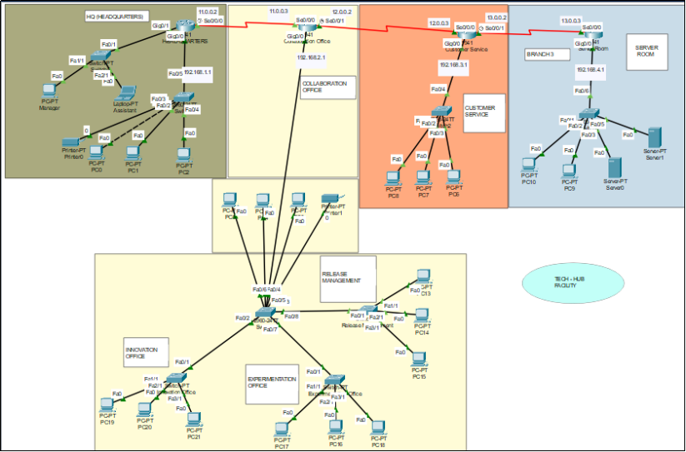

Slide 11
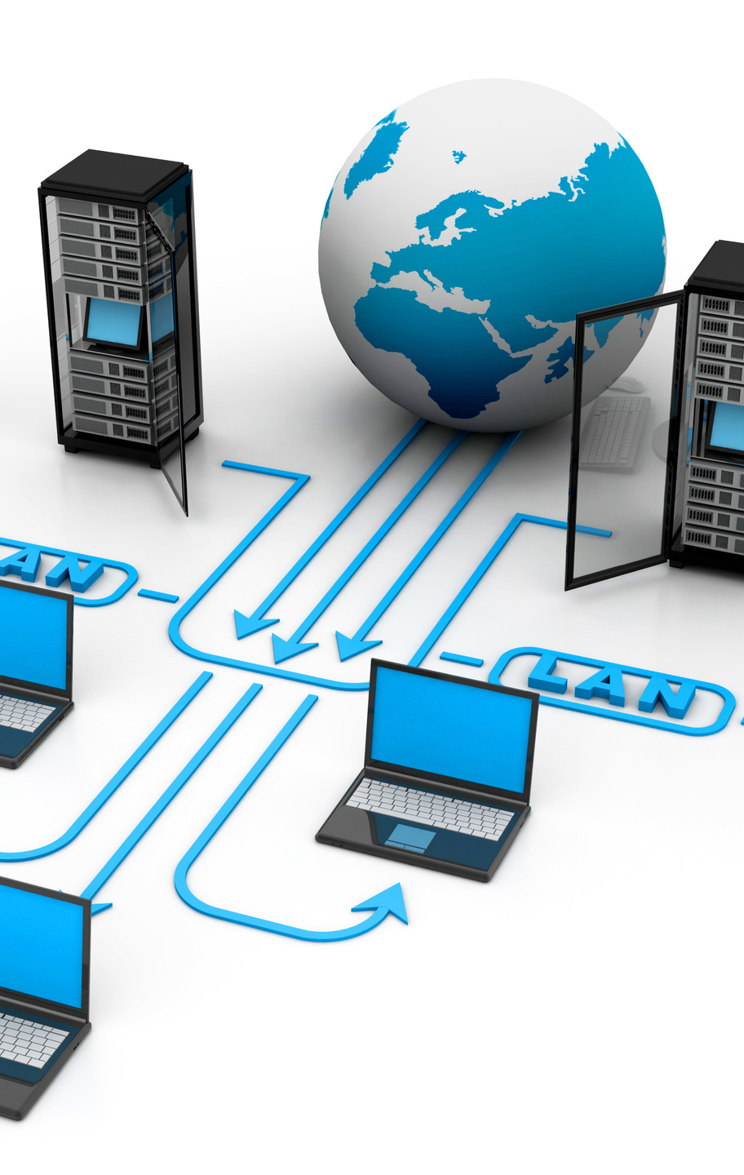
1. Network Topology
Topology Type: Hybrid Topology (Star + Point-to-Point WAN)
The network design uses a Hybrid Topology, which combines Star Topology for LAN configurations withineachlocation and Point-to-Point WAN links for inter-site connectivity.

Slide 12

Why This Topology is Suitable for the Project:
1. Scalability
2. Reliability and Redundancy
3. Centralized Management
4. Optimized Bandwidth Usage
5. Cost-Effectiveness

Slide 13
Network Overview:
Headquarters (HQ): Subnet 192.168.1.0/24 
Branch 1: Subnet 192.168.2.0/24 
Branch 2: Subnet 192.168.3.0/24 
Branch 3: Subnet 192.168.4.0/24 
WAN Links: Using the range 10.0.0.0/30 for point-to-point inter-site connections.

Slide 14
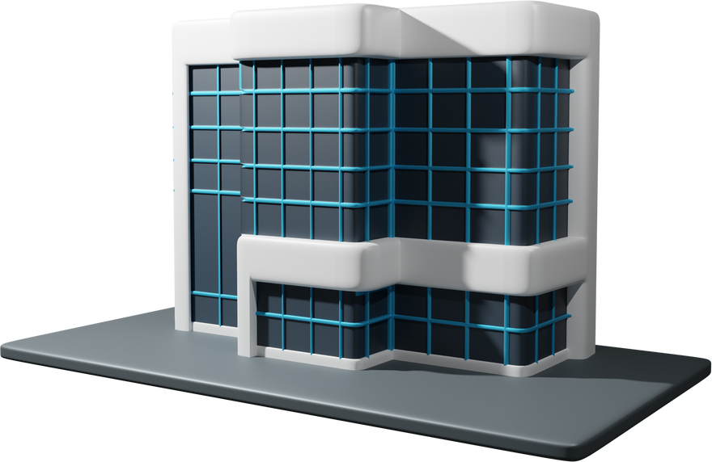
Headquarters (HQ):
Subnet: 192.168.1.0/24 
Core Devices:
1. Router R1 with GigabitEthernet and Serial interfaces.
2. PCs (PC0-5), Printer0, and a centralized DHCP server.

Slide 15

Branch 1:
Subnet: 192.168.2.0/24 
Core Devices:
1. Router R2 connected to HQ via a Serial link.
2. PCs (PC6-8), IP Phone6, and Printer1.

Slide 16

Branch 2:
Subnet: 192.168.3.0/24
Core Devices:
1. Router R3 connected to HQ via Serial link.
2. PCs (PC9-11), IP Phone3, and a server cluster.

Slide 17
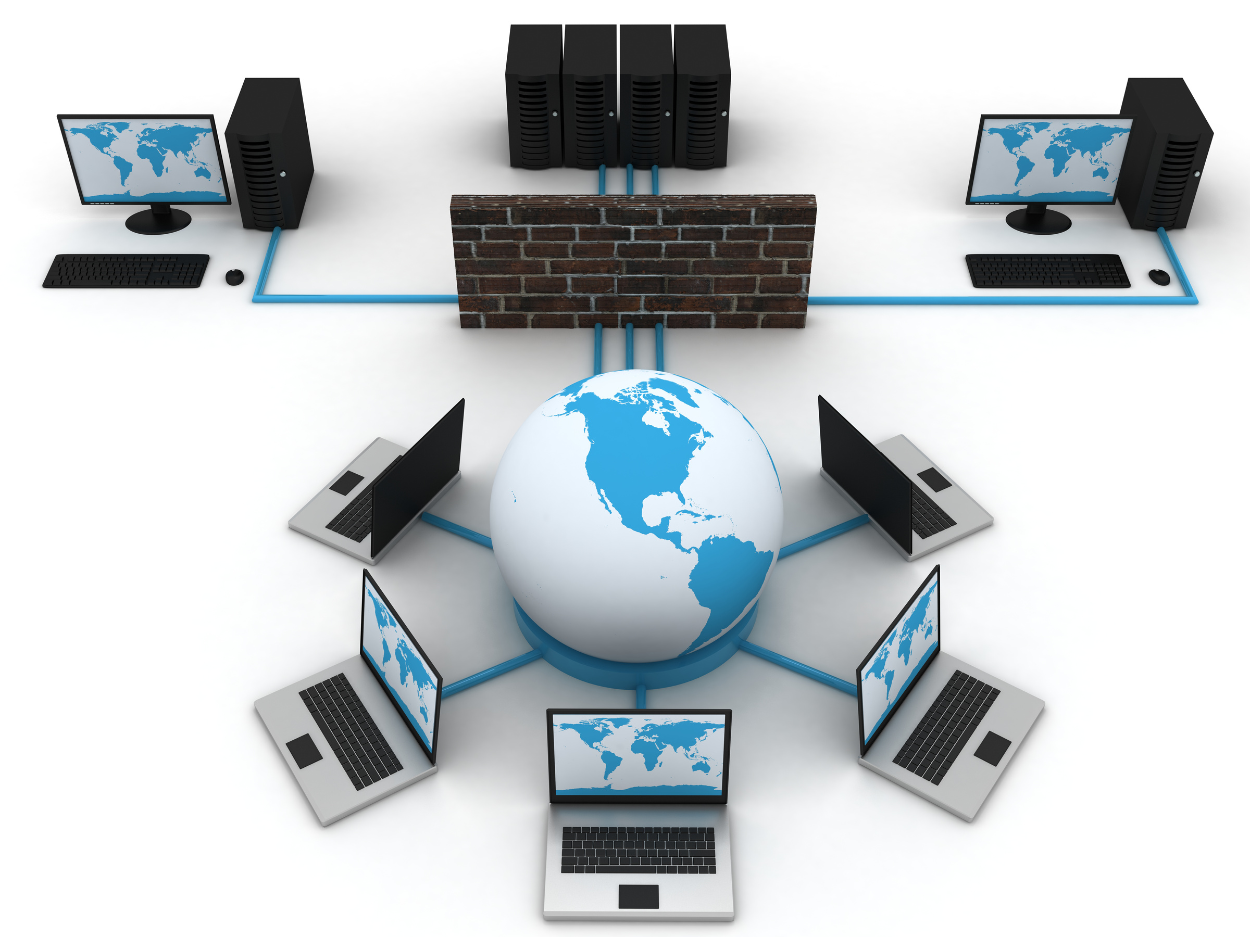
Branch 3:
Subnet: 192.168.4.0/24 
Core Devices:
1. Router R4 connected to HQ via a Serial link.
2. Devices include PCs (PC12-15) and IoT devices (e.g., sensors, smart boards) used for collaborative techlabs.

Slide 18
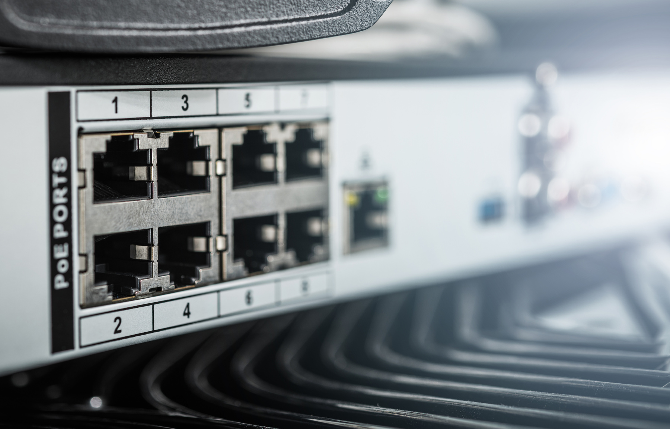
WAN Network:
IP Range: 10.0.0.0/30 for Serial links between routers (HQ to Branch 1, 2, and 3).

Slide 19
HQ Router R1: 192.168.1.1
2. Design Explanation
Branch 1 Router R2: 192.168.2.1
DHCP Configuration:
Centralized DHCP Server: Located at HQ, serving the local subnet (192.168.1.0/24).  DHCP Relay Agents: Configured on R2, R3, and R4 for Branch 1, Branch 2, and Branch 3 to enable dynamicIPallocation.
Branch 2 Router R3: 192.168.3.1
Static Assignments:
Static IPs are assigned to critical devices for reliability:
Branch 3 Router R4: 192.168.4.1

Slide 20

Security Features:
VLANs: Configured to segment tenant traffic and administrative traffic.
Encryption: Use of secure protocols such as WPA3 for wireless and SSL/TLS for management interfaces.
Firewalls and ACLs: Deployed to filter traffic and prevent unauthorized access.

Slide 21

Part 3: Configuration and Implementation
1. Router and Switch Configuration
Hostnames, encrypted passwords, and basic security applied to all devices. 
DHCP Setup:
Centralized DHCP server with relay agents at each branch.
Static bindings for servers and printers to ensure consistent addressing.VLAN Configuration:

Slide 22


Part 3: Configuration and Implementation
VLAN Configuration: - VLANs for tenant and admin traffic, with inter-VLAN routing for management.
2. Security Configuration 
ACLs applied to control traffic flows. 
Encrypted passwords and management access.
IDS/IPS for monitoring and firewall for traffic filtering.

Slide 23
Part 4: Advanced Testing and Analysis
1. Simulations and Tests
Scenarios:
●
Redundancy: Simulate device and link failures to validate EIGRP failover mechanisms and redundancy.
DHCP Testing: Validate dynamic IP allocation at HQ, Branch 1, Branch 2, and Branch 3, ensuring proper relay agent functionality.
EIGRP Performance: Validate convergence times and routing table accuracy
Testing Tools: Cisco Packet Tracer for simulation and analysis.

Slide 24
2. Document and Evaluate
Testing Results: 
Successful DHCP Allocation: Confirmed for all subnets. 
EIGRP Failover: Verified seamless route failover and reconvergence. 
Connectivity: Full end-to-end communication validated across all devices and locations.

Slide 25
Conclusion
The Hybrid Topology combining Star Topology for LANs and Point-to-Point WAN links for branch connectionsisideal for the tech hub facility. This topology meets the project goals of scalability, reliability, and security whileenabling centralized management and efficient resource utilization.

Slide 26
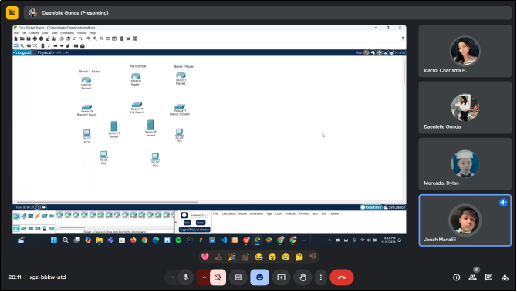
DOCUMENTATION:

Slide 27
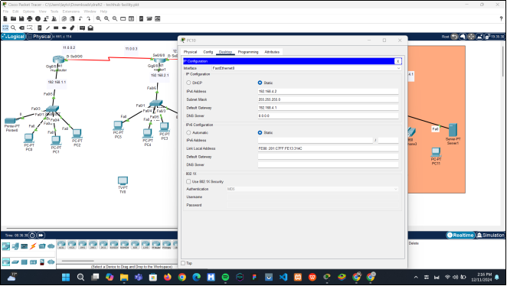
DOCUMENTATION:

Slide 28
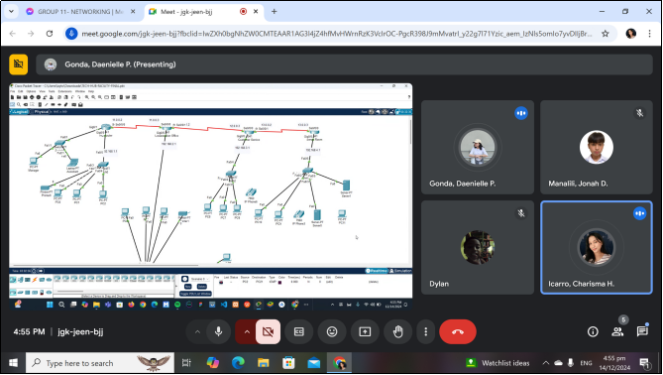
DOCUMENTATION:

Slide 29
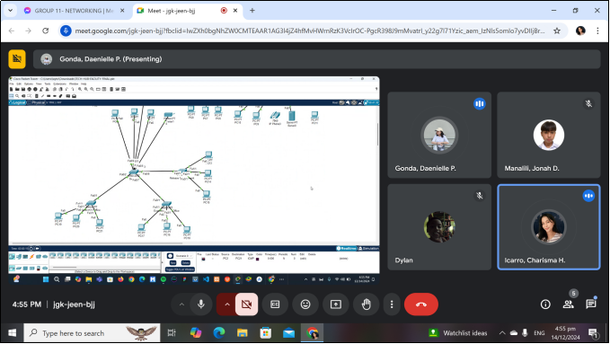
DOCUMENTATION:

Slide 30
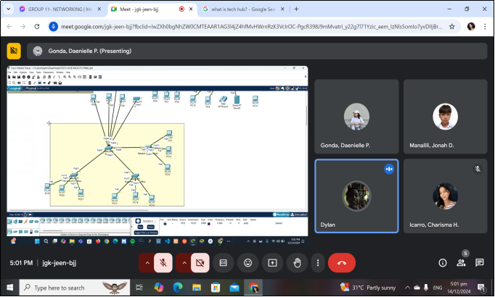
DOCUMENTATION:

Slide 31
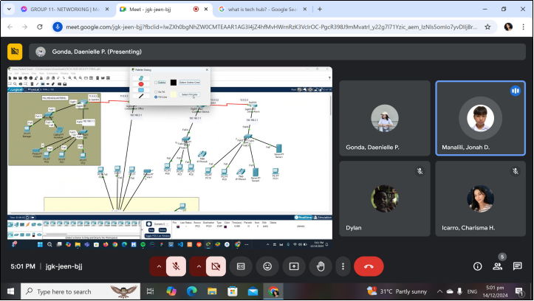
DOCUMENTATION:

Slide 32
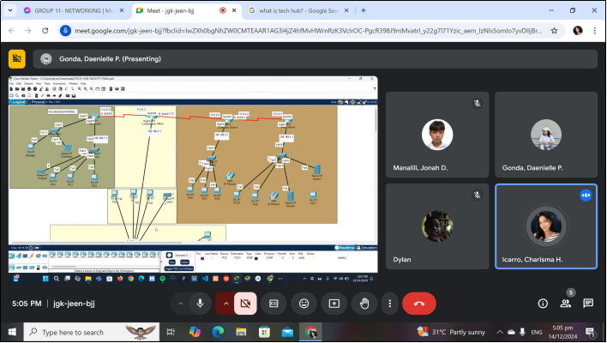
DOCUMENTATION:

Slide 33
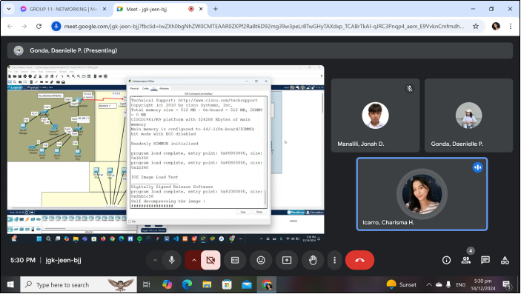
DOCUMENTATION:

Slide 34
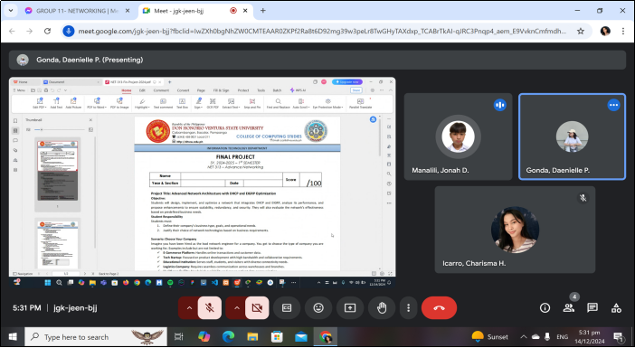
DOCUMENTATION:

Slide 35


THANK YOU!
BSIT-3M
Gonda, Daenielle P.
Icarro, Charisma H.
Manalili, Jonah D.
Mercado, Dylan M.

